Slide 1
AJAX Patterns
Change Browser Content with the DOM
  Return HTML or XML and change named items
    Usually DIVs or SPANs
Remote Scripting
  Execute business functions on the server from the client
Events & Scheduling
  Using Timers to ping server on regular basis
Specialized Functions to perform common GUI tasks
  Populate SELECT list
  Pass target DIV to replace to the server
  Instant Validation as User Works
  SAVE instead of SUBMIT
  CANCEL instead of BACK
DHTML Techniques
  CSS, Drag & Drop
Server-Side Code Generation
  Return Javascript to client

Slide 2
AJAX Frameworks
Pure JavaScript Framework
  Infrastructure
    Provides basic piping & portable browser abstractions
    Content up to developer
    Typical Functionality:
      Wrapper around XMLHttpRequest
      XML manipulation & interrogation
      DOM manipulations based on responses from XMLHttpRequest
  Application Framework
    Includes basic Infrastruture functionality
Server-Side Framework
  HTML/JavaScript Generation
    Server provides complete HTML/JS code generation and browser ←→ server coordination
    Browser-side coding is for customization
  Remote Invocation
    JavaScript calls routed directly to server-side functions (Java Methods) and returned back to Javascript callback handlers

Slide 3
Pure JavaScript
  DOJO (9/04)
  Prototype (2001)
  Open Rico (5/05)
  Qooxdoo (5/05)
Pure JavaScript Infrastructural
  AjaxJS (5/05)
  HTMLHttpRequest (2001)
  Interactive Website Framework (5/05)
  LibXMLHttpRequest (6/03)
  RSLite
  Sack (5/05)
  Sarissa (2/03)
  XHConn (4/05)
Server-Side (Multi Language)
  Cross-Platform Asynchronous Interface Toolkit (5/05)
  SAJAX (3/05)
  Javascript Object Notation (JSON) & JSON-RPC
  Javascript Remote Scripting (2000)
Server-Side (Java)
  Echo2 (3/05)
  Direct Web Remoting (DWR) (2005)]
  ThinkCAP Minerva (04/2005)
Server-Side (Lisp)
  CL-Ajax
Server-Side (.NET)
  Ajax.NET (305)
Server-Side (PHP)
  AjaxAC (4/05)
  JPSpan
  XAJAX
Server-Side (Ruby)
  Ruby-On-Rails (3/05)
Pick a
Framework…
any Framework
www.ajaxpatterns.org

Slide 4
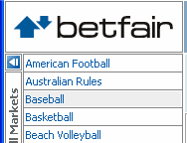
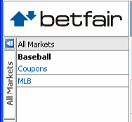
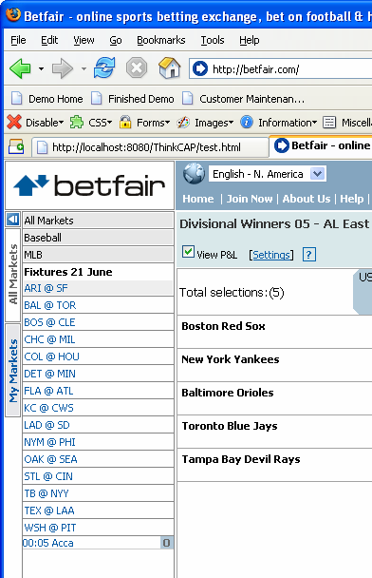
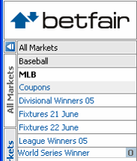
Common Widgets
Form Validation
Interactive Grids
Drilldowns TreeViews
Auto Completion
Application Status Area
Progress Bars
Dynamic Lists
Tabs
AJAX’ed Portlets
Predictive Fetch

Slide 5
Sites of Interest
www.ajaxmatters.com
www.ajaxian.com
www.ajaxpatterns.org
Foundational Libraries
  Prototype
  script.acul.us
    very OO foundation to manipulate XMLHTTPRequest
    lots of visual effects, autocomplete, sliders, controls
    Core of “Ruby on Rails” AJAX implementation
  OpenRico
    Builds on Prototype, adds some controls
    Accordion, Live Grid
  Sarissa
    Heavy duty XML library for XSLT
  SAJAX & XAJAX
    PHP libraries with some good ideas
    Server driven JS creation

Slide 6
Basic AJAX Process
JavaScript
– Define an object for sending HTTP requests
– Initiate request
  • Get request object
  • Designate a request handler function
    – Supply as onreadystatechange attribute of request
  • Initiate a GET or POST request
  • Send data
– Handle response
  • Wait for readyState of 4 and HTTP status of 200
  • Extract return text with responseText or responseXML
  • Do something with result
• HTML
  – Loads JavaScript
  – Designates control that initiates request
  – Gives ids to input elements that will be read by script

Slide 7
Define Object
var request;
function getRequestObject()
{
if (window.ActiveXObject) {
return(new ActiveXObject("Microsoft.XMLHTTP"));
} else if (window.XMLHttpRequest) {
return(new XMLHttpRequest());
} else {
return(null);
}
}

Slide 8
Initiate Request
function sendRequest() {
request = getRequestObject();
request.onreadystatechange = handleResponse;
request.open("GET", "message-data.html", true);
request.send(null);
}

Slide 9
Handling Response
function handleResponse()
{
if (request.readyState == 4) {
alert(request.responseText);
}
}

Slide 10
HTML Code
<!DOCTYPE html PUBLIC "..."
"http://www.w3.org/TR/xhtml1/DTD/xhtml1-transitional.dtd">
<html xmlns="http://www.w3.org/1999/xhtml">
<head><title>Ajax: Simple Message</title>
<script src="mesg.js"
type="text/javascript"></script>
</head>
<body>
<center>
<table border="1" bgcolor="gray">
<tr><th><big>Ajax: Simple Message</big></th></tr>
</table>
<p/>
<form action="#">
<input type="button" value="Show Message"
onclick="sendRequest()"/>
</form>
</center></body></html>

Slide 11
AJAX DB Example

Slide 12
HTML File
<html>
<head>
<script src="select_name.js"></script>
</head><body><form>
Select a State:
<select name="cities" onchange="showCityname(this.value)">
<option value="Tamilnadu">Tamilnadu
<option value="Kerala ">Kerala
<option value="Karnataka">Karnataka
</select>
</form><p>
<div id="txtHint"><b>City Names will be listed here.</b></div>
</p>
</body>
</html>
Java Script File
JavaScript Function Call

Slide 13
Java Script File – Show Cityname() Function
var xmlHttp
function showCityname(str)
{
xmlHttp=GetXmlHttpObject();
if (xmlHttp==null)
{
alert ("Your browser does not support AJAX!");
return;
}
var url="http://10.1.6.32/ajax/getname.php";
url=url+"?q="+str;
url=url+"&sid="+Math.random();
xmlHttp.onreadystatechange=stateChanged;
xmlHttp.open("GET",url,true);
xmlHttp.send(null);
}

Slide 14
AJAX - Sending a Request to the Server
To send off a request to the server, we use the open() method and the send() method.
The open() method takes three arguments. The first argument defines which method to use when sending the request (GET or POST). The second argument specifies the URL of the server-side script. The third argument specifies that the request should be handled asynchronously. The send() method sends the request off to the server. If we assume that the HTML and PHP file are in the same directory, the code would be:
xmlHttp.open("GET",“getname.php",true); xmlHttp.send(null);

Slide 15
Defines the url (filename) to send to the server
Adds a parameter (q) to the url with the content of the input field
Adds a random number to prevent the server from using a cached file
Creates an XMLHTTP object, and tells the object to execute a function called stateChanged when a change is triggered
Opens the XMLHTTP object with the given url.
Sends an HTTP request to the server

Slide 16
Javascript- State Changed
function stateChanged()
{
if (xmlHttp.readyState==4)
{
document.getElementById("txtHint").innerHTML=xmlHttp.responseText;
}
}

Slide 17
State changed Function
The readyState property holds the status of the server's response. Each time the readyState changes, the onreadystatechange function will be executed.
Request is not initialized -0
The request has been set up – 1
The request has been sent - 2
The request is in process – 3
The request is complete - 4

Slide 18
JavaScript – Define XmlHttpObject
function GetXmlHttpObject()
{
var xmlHttp=null;
try
{
// Firefox, Opera 8.0+, Safari
xmlHttp=new XMLHttpRequest();
}
catch (e)
{
// Internet Explorer
try
{
xmlHttp=new ActiveXObject("Msxml2.XMLHTTP");
}
catch (e)
{
xmlHttp=new ActiveXObject("Microsoft.XMLHTTP");
}
}
return xmlHttp;
}

Slide 19
XMLHttpRequest Properties
onreadystatechange
  Event handler that fires at each state change
  You implement your own function that handles this
readyState – current status of request
  0 = uninitialized
  1 = loading
  2 = loaded
  3 = interactive (some data has been returned)
    This is broken in IE right now
  4 = complete
status
  HTTP Status returned from server: 200 = OK
responseText
  String version of data returned from server
responseXML
  XML DOM document of data returned
statusText
  Status text returned from server

Slide 20
PHP Code – Server Script
<?php
header("Cache-Control: no-cache, must-revalidate");
// Date in the past
header("Expires: Mon, 26 Jul 1997 05:00:00 GMT");
$q=$_GET["q"];//lookup all hints from array if length of q>0
$query = " select city from city where state = '$q' ";
$mysql_link=mysql_connect("10.1.6.32","guest","");
mysql_select_db("test",$mysql_link);
$mysql_result = mysql_query($query, $mysql_link);
$response= "<table>";
while ( $row = mysql_fetch_row($mysql_result))
{ $city = $row[0];
$response.="<tr><td><b>".$city."</b></td></tr>";
}
$response.="</table>";
echo $response;
?>

Slide 21
Client-Side Tools
– Dojo.
• Open source JavaScript toolkit with Ajax support
• http://www.dojotoolkit.org/
– Google Web Toolkit
• Write code in Java, translate it to JavaScript
• http://code.google.com/webtoolkit/
– script.aculo.us
• Free JavaScript toolkit with Ajax support
• http://script.aculo.us/
– Yahoo User Interface Library (YUI)
• Free JavaScript toolkit with some Ajax support
• http://developer.yahoo.com/yui/

Slide 22
Server-Side Tools
– Direct Web Remoting
• Lets you call Java methods semi-directly from JavaScript
• http://getahead.ltd.uk/dwr/
– JSON/JSON-RPC
• For sending data to/from JavaScript with less parsing
• http://www.json.org/
• http://json-rpc.org/
– JSP custom tag libraries
• Create tags that generate into HTML and JavaScript
• http://courses.coreservlets.com/Course-Materials/msajsp.html
84 J2EE training: http://courses.coreservlets.com

Slide 23
Questions?

